Slide 1
Within the context of human resources (HR), attrition is a reduction in the workforce caused by retirement or resignation. This is a serious problem faced by several organizations around the world as attrition is economically damaging to the organizations as the replacement employees have to be hired at a cost and trained again at a cost. High Rates of Attrition also damages the brand value of the company. Now the Dataset belongs to a very fast-growing company. This company has witnessed several employees leaving the company in the last 3 years. The company’s HR team has always been reactive to attrition but now the team wants to be proactive and wished to predict attrition of employees using the data they have in hand. The goal here is to predict whether an employee will leave the company based upon the various variables given in the dataset. Working with Data Data has been split into two groups and provided in the module: training set test set The training set is used to build your machine learning model. For the training set, we provide the attrition details of an employee. The test set should be used to see how well your model performs on unseen data. For the test set, it is your job to predict the attrition value of an employee. Metric to measure Accuracy is the metric to measure the performance. Accuracy= (TP+TN)/(TP+TN+FP+FN)

Slide 2
The file should have exactly two columns
1. EmployeeID (sorted in any order)
2. Attrition

Slide 3
ATTRITION
Meaning
Employee attrition refers to the deliberate downsizing of a company's workforce. Downsizing happens when employees resign or retire. This type of reduction in staff is called a hiring freeze. It is one way a company can decrease labor costs without the disruption of layoffs. There are a number of reasons why employee attrition takes place.
How does attrition affect a company?
Attrition can force a firm to identify the issues that may be causing it. It also allows companies to cut down labor costs as employees leave by choice and they're not replaced. Eventually, it can lead to the hiring of new employees with fresh ideas and energy.

Slide 4
Education
1. Below College; 2. College; 3. Bachelor; 4. Master; 5. Doctor
EnvironmentSatisfaction
1. Low; 2. Medium; 3. High; 4. Very High
JobInvolvement
1. Low; 2. Medium; 3. High; 4. Very High
JobSatisfaction
1. Low; 2. Medium; 3. High; 4. Very High
PerformanceRating
Low; 2. Good; 3. Excellent; 4. Outstanding
RelationshipSatisfaction
1. Low; 2. Medium; 3. High; 4. Very High
WorkLifeBalance
1. Bad; 2. Good; 3. Better; 4. Best

Slide 6
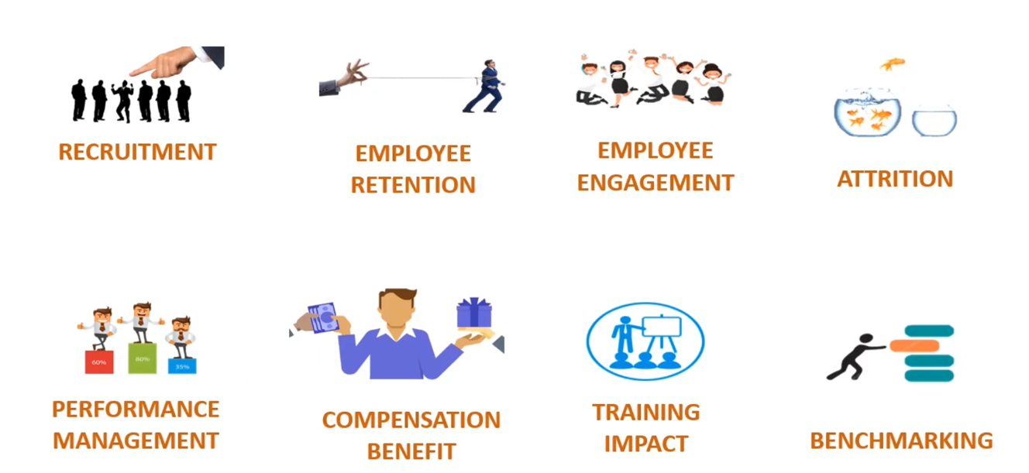

Slide 7
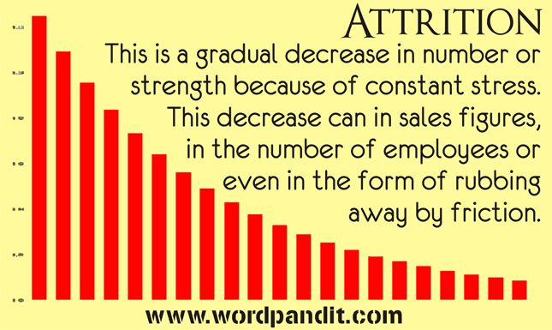

Slide 8
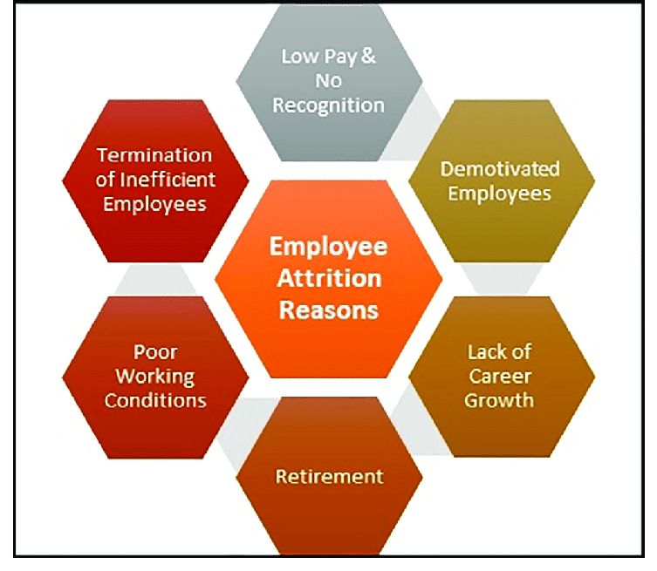
REASONS FOR ATTRITION

